Slide 1
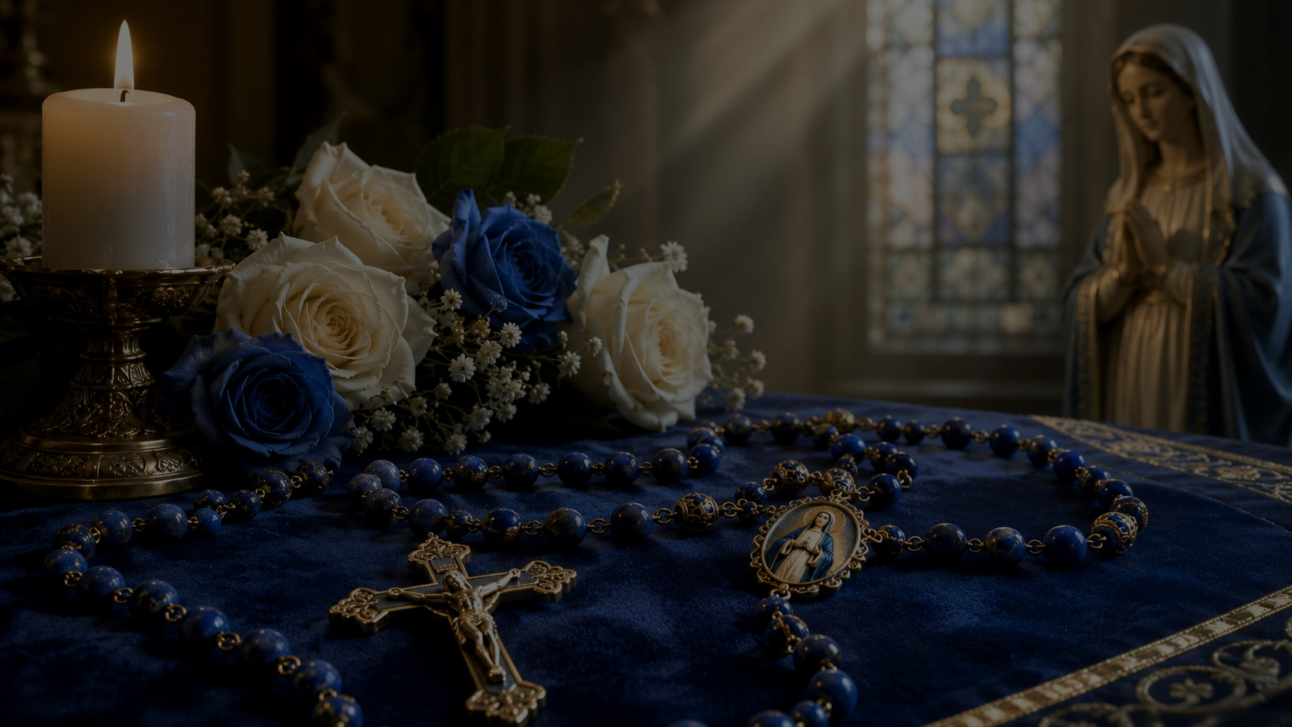
Welcome to
St. Mary’s Virtual
Rosary Ministry
St. Mary’s Church – Park City, Utah
“They devoted themselves to prayer… with Mary.”
Acts 1:14
St. Mary’s Virtual Rosary Ministry
Notes:
Welcome to St Mary’s virtual Rosary. My name is ______ and I will lead the Rosary. If less than ten participants then state: “Please join me in saying the “All” portions.” If greater than ten participants, ask another St Mary’s leader to state the “All” responses.
Pause….Let’s us begin

Slide 2
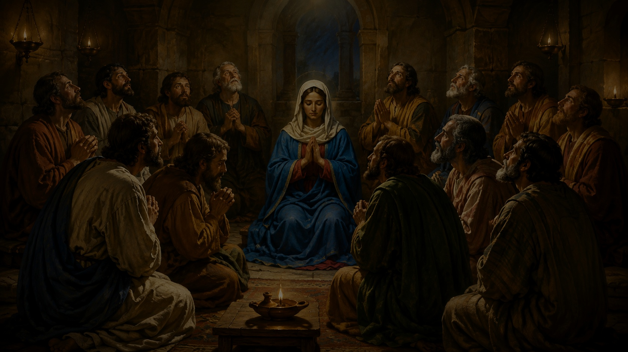
The Upper Room Rosary
“They devoted themselves to prayer… with Mary.” Acts 1:14
Today we gather online to pray the Holy Rosary in a spirit of faith, unity, and hope.
Inspired by the disciples who prayed with Mary in the Upper Room, this ministry brings together individuals and families from our parish and beyond. Participants may join from home, while traveling, or from anywhere in the world.
St. Mary’s Virtual Rosary Ministry

Slide 3
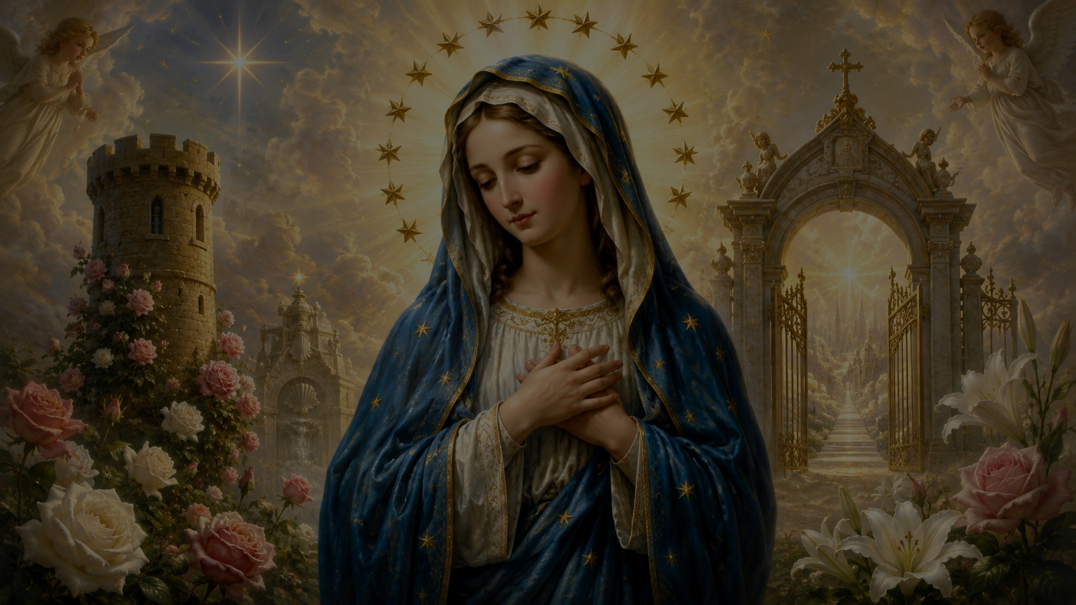
Let us begin…
Sign of the Cross
In the name of the Father, and of the Son, and of the Holy Spirit. Amen.
St. Mary’s Virtual Rosary Ministry

Slide 4
Opening Prayer
Leader and all respond together
Leader
O God, come to my assistance.
All
O Lord, make haste to help me.
Leader
Glory be to the Father, and to the Son, and to the Holy Spirit.
All
As it was in the beginning, is now, and ever shall be, world without end. Amen.
St. Mary’s Virtual Rosary Ministry

Slide 5
Rosary Intentions
Parish, families, sick, vocations, peace, and the faithful departed
Leader
Let us offer this Rosary for the intentions of our parish, our families, the sick, those who are struggling physically, mentally, or spiritually, vocations, peace in the world, those who have died, and all intentions entrusted to our prayers.
Leader
At this time, if anyone has a special intention they would like to share, please feel free to type it in the Zoom chat. Pause and review intentions.
Leader
We also entrust to the Blessed Virgin Mary the intentions that remain unspoken in our hearts. Together, let us begin.
St. Mary’s Virtual Rosary Ministry

Slide 6
Apostles’ Creed
The profession of faith
All
I believe in God, the Father almighty, Creator of heaven and earth, and in Jesus Christ, his only Son, our Lord, who was conceived by the Holy Spirit, born of the Virgin Mary, suffered under Pontius Pilate, was crucified, died and was buried; he descended into hell; on the third day he rose again from the dead; he ascended into heaven, and is seated at the right hand of God the Father almighty; from there he will come to judge the living and the dead.
I believe in the Holy Spirit, the holy Catholic Church, the communion of saints, the forgiveness of sins, the resurrection of the body, and life everlasting. Amen.
St. Mary’s Virtual Rosary Ministry

Slide 7
Opening Beads
For faith, hope, and charity
Our Father
Three Hail Marys
For an increase in Faith, Hope, and Charity.
Hail Mary, full of grace, the Lord is with thee. Blessed art thou among women, and blessed is the fruit of thy womb, Jesus.
All: Holy Mary, Mother of God, pray for us sinners, now and at the hour of our death. Amen.
Our Father, who art in heaven, hallowed be thy name; thy kingdom come; thy will be done on earth as it is in heaven.
All: Give us this day our daily bread, and forgive us our trespasses, as we forgive those who trespass against us; and lead us not into temptation but deliver us from evil. Amen.
Glory Be
Glory be to the Father, and to the Son, and to the Holy Spirit.
All: As it was in the beginning, is now, and ever shall be, world without end. Amen.
St. Mary’s Virtual Rosary Ministry

Slide 8
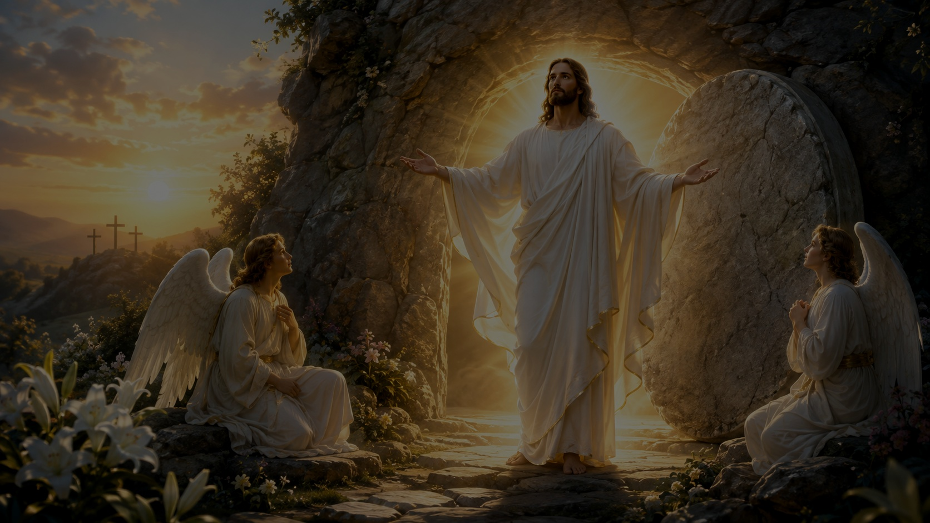
First Glorious Mystery
The Resurrection
“Why do you seek the living among the dead? He is not here, but has risen.” (Luke 24:1–5)
St. Mary’s Virtual Rosary Ministry

Slide 9
First Decade Prayers
The Resurrection
Our Father
Our Father, who art in heaven, hallowed be thy name; thy kingdom come; thy will be done on earth as it is in heaven.
All: Give us this day our daily bread, and forgive us our trespasses, as we forgive those who trespass against us; and lead us not into temptation but deliver us from evil. Amen.
Ten Hail Marys
Contemplating the mystery.
Hail Mary, full of grace, the Lord is with thee. Blessed art thou among women, and blessed is the fruit of thy womb, Jesus.
All: Holy Mary, Mother of God, pray for us sinners, now and at the hour of our death. Amen.
Glory Be
Glory be to the Father, and to the Son, and to the Holy Spirit.
All: As it was in the beginning, is now, and ever shall be, world without end. Amen.
Fatima Prayer
All: O my Jesus, forgive us our sins, save us from the fires of hell; lead all souls to heaven, especially those in most need of thy mercy.
St. Mary’s Virtual Rosary Ministry

Slide 10
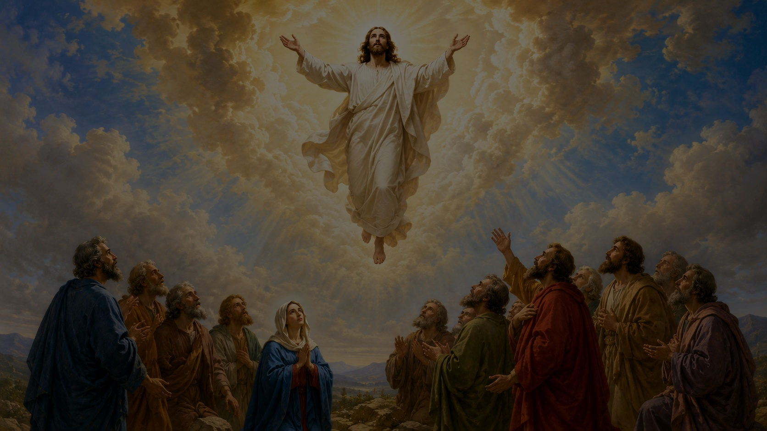
Second Glorious Mystery
The Ascension
“The Lord Jesus, after he had spoken to them, was taken up into heaven, and sat down at the right hand of God.” (Mark 16:19)
St. Mary’s Virtual Rosary Ministry

Slide 11
Second Decade Prayers
The Ascension
Our Father
Our Father, who art in heaven, hallowed be thy name; thy kingdom come; thy will be done on earth as it is in heaven.
All: Give us this day our daily bread, and forgive us our trespasses, as we forgive those who trespass against us; and lead us not into temptation but deliver us from evil. Amen.
Ten Hail Marys
Contemplating the mystery.
Hail Mary, full of grace, the Lord is with thee. Blessed art thou among women, and blessed is the fruit of thy womb, Jesus.
All: Holy Mary, Mother of God, pray for us sinners, now and at the hour of our death. Amen.
Glory Be
Glory be to the Father, and to the Son, and to the Holy Spirit.
All: As it was in the beginning, is now, and ever shall be, world without end. Amen.
Fatima Prayer
All: O my Jesus, forgive us our sins, save us from the fires of hell; lead all souls to heaven, especially those in most need of thy mercy.
St. Mary’s Virtual Rosary Ministry

Slide 12
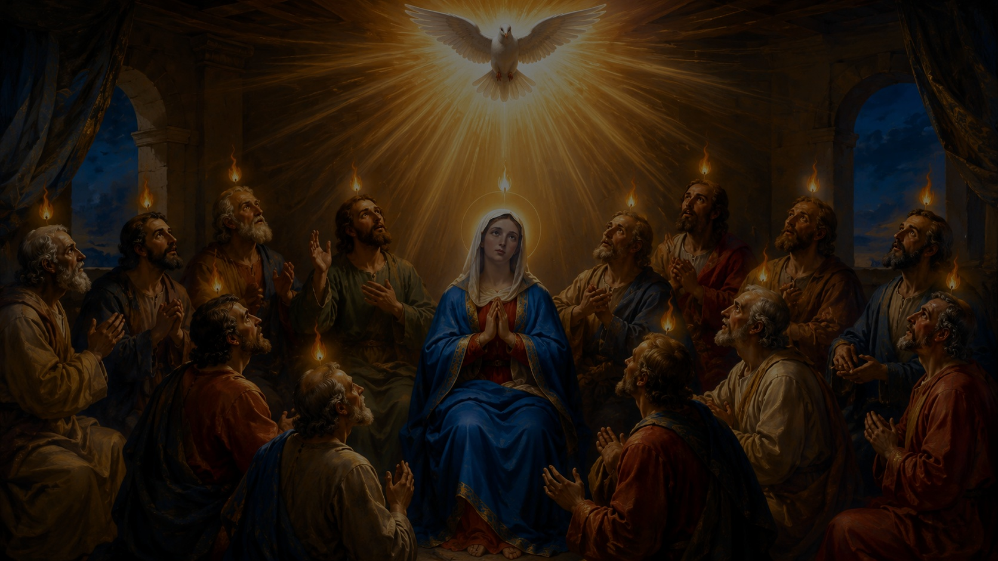
Third Glorious Mystery
The Descent of the Holy Spirit
“They were all filled with the Holy Spirit and began to speak in other tongues, as the Spirit gave them utterance.” (Acts 2:1–4)
St. Mary’s Virtual Rosary Ministry

Slide 13
Third Decade Prayers
The Descent of the Holy Spirit
Our Father
Our Father, who art in heaven, hallowed be thy name; thy kingdom come; thy will be done on earth as it is in heaven.
All: Give us this day our daily bread, and forgive us our trespasses, as we forgive those who trespass against us; and lead us not into temptation but deliver us from evil. Amen.
Ten Hail Marys
Contemplating the mystery.
Hail Mary, full of grace, the Lord is with thee. Blessed art thou among women, and blessed is the fruit of thy womb, Jesus.
All: Holy Mary, Mother of God, pray for us sinners, now and at the hour of our death. Amen.
Glory Be
Glory be to the Father, and to the Son, and to the Holy Spirit.
All: As it was in the beginning, is now, and ever shall be, world without end. Amen.
Fatima Prayer
All: O my Jesus, forgive us our sins, save us from the fires of hell; lead all souls to heaven, especially those in most need of thy mercy.
St. Mary’s Virtual Rosary Ministry

Slide 14
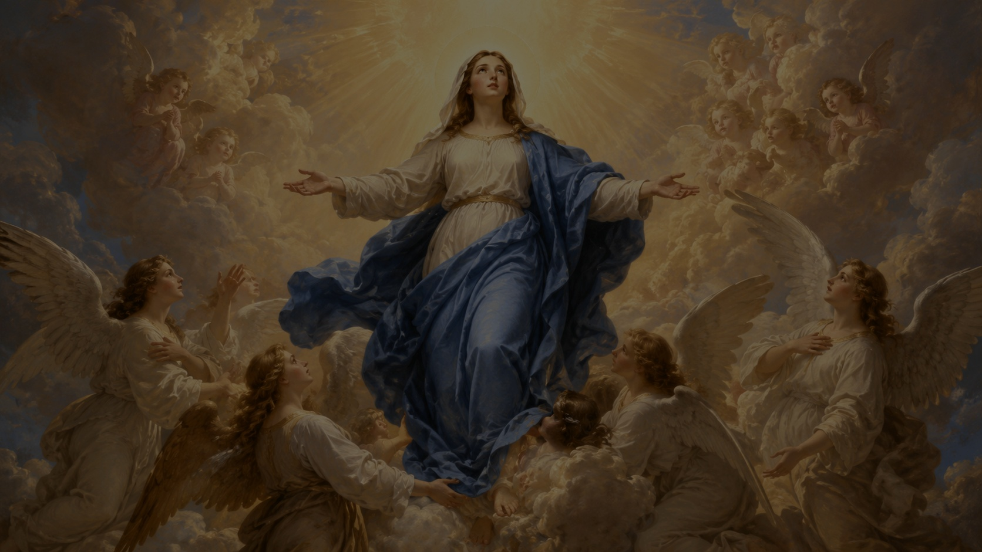
Fourth Glorious Mystery
The Assumption
“Henceforth all generations will call me blessed; for he who is mighty has done great things for me.” (Luke 1:48–49)
St. Mary’s Virtual Rosary Ministry

Slide 15
Fourth Decade Prayers
The Assumption
Our Father
Our Father, who art in heaven, hallowed be thy name; thy kingdom come; thy will be done on earth as it is in heaven.
All: Give us this day our daily bread, and forgive us our trespasses, as we forgive those who trespass against us; and lead us not into temptation but deliver us from evil. Amen.
Ten Hail Marys
Contemplating the mystery.
Hail Mary, full of grace, the Lord is with thee. Blessed art thou among women, and blessed is the fruit of thy womb, Jesus.
All: Holy Mary, Mother of God, pray for us sinners, now and at the hour of our death. Amen.
Glory Be
Glory be to the Father, and to the Son, and to the Holy Spirit.
All: As it was in the beginning, is now, and ever shall be, world without end. Amen.
Fatima Prayer
All: O my Jesus, forgive us our sins, save us from the fires of hell; lead all souls to heaven, especially those in most need of thy mercy.
St. Mary’s Virtual Rosary Ministry

Slide 16
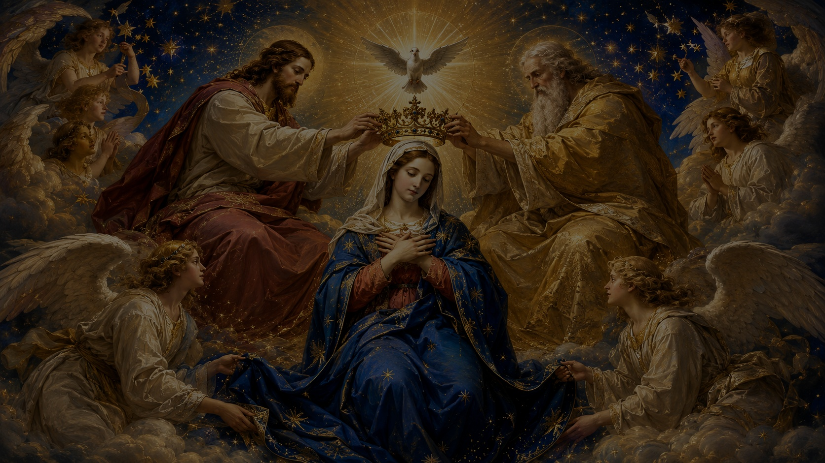
Fifth Glorious Mystery
The Coronation of Our Lady
“A great sign appeared in heaven: a woman clothed with the sun, with the moon under her feet, and on her head a crown of twelve stars.” (Revelation 12:1)
St. Mary’s Virtual Rosary Ministry

Slide 17
Fifth Decade Prayers
The Coronation of Our Lady
Our Father
Our Father, who art in heaven, hallowed be thy name; thy kingdom come; thy will be done on earth as it is in heaven.
All: Give us this day our daily bread, and forgive us our trespasses, as we forgive those who trespass against us; and lead us not into temptation but deliver us from evil. Amen.
Ten Hail Marys
Contemplating the mystery.
Hail Mary, full of grace, the Lord is with thee. Blessed art thou among women, and blessed is the fruit of thy womb, Jesus.
All: Holy Mary, Mother of God, pray for us sinners, now and at the hour of our death. Amen.
Glory Be
Glory be to the Father, and to the Son, and to the Holy Spirit.
All: As it was in the beginning, is now, and ever shall be, world without end. Amen.
Fatima Prayer
All: O my Jesus, forgive us our sins, save us from the fires of hell; lead all souls to heaven, especially those in most need of thy mercy.
St. Mary’s Virtual Rosary Ministry

Slide 18
Intentions of the Holy Father
For the grace of obtaining the plenary indulgence
Leader
Let us now pray for the intentions of our Holy Father, Pope Leo XIV, and for the grace of obtaining the plenary indulgence.
Our Father
Our Father, who art in heaven, hallowed be thy name; thy kingdom come; thy will be done on earth as it is in heaven. All: Give us this day our daily bread, and forgive us our trespasses, as we forgive those who trespass against us; and lead us not into temptation but deliver us from evil. Amen.
Three Hail Marys
Hail Mary, full of grace, the Lord is with thee. Blessed art thou among women, and blessed is the fruit of thy womb, Jesus.
All: Holy Mary, Mother of God, pray for us sinners, now and at the hour of our death. Amen.
Glory Be
Glory be to the Father, and to the Son, and to the Holy Spirit.
All: As it was in the beginning, is now, and ever shall be, world without end. Amen.
St. Mary’s Virtual Rosary Ministry

Slide 19
Hail, Holy Queen
The Salve Regina
All
Hail, Holy Queen, Mother of Mercy, our life, our sweetness, and our hope. To thee do we cry, poor banished children of Eve; to thee do we send up our sighs, mourning and weeping in this valley of tears.
Turn then, most gracious Advocate, thine eyes of mercy toward us; and after this our exile, show unto us the blessed fruit of thy womb, Jesus.
O clement, O loving, O sweet Virgin Mary.
Leader / All
Pray for us, O holy Mother of God.
That we may be made worthy of the promises of Christ.
St. Mary’s Virtual Rosary Ministry

Slide 20
Rosary Closing Prayer
Let us pray
O God, whose Only Begotten Son, by His life, death, and resurrection, has purchased for us the rewards of eternal life; grant, we beseech Thee, that while meditating upon these mysteries of the Most Holy Rosary of the Blessed Virgin Mary, we may imitate what they contain and obtain what they promise, through the same Christ our Lord. Amen.
St. Mary’s Virtual Rosary Ministry
Notes:
We will begin the closing prayers and for those who you would like to remain we will continue with Litany of Loreto.

Slide 21
Litany of Loreto
Beginning of the litany
Invocation
Holy Mother of God
Lord have mercy.
All: Christ have mercy.
Lord have mercy.
Christ hear us.
All: Christ graciously hear us.
God, the Father of heaven,
All: have mercy on us.
God the Son, Redeemer of the world,
All: have mercy on us.
God the Holy Spirit,
All: have mercy on us.
Holy Trinity, one God,
All: have mercy on us.
Holy Mary,
All: pray for us. (after each)
Holy Mother of God,
Holy Virgin of virgins,
Mother of Christ,
Mother of the Church,
Mother of Mercy,
Mother of divine grace,
Mother of Hope,
Mother most pure,
Mother most chaste,
Mother inviolate,
Mother undefiled,
Mother most amiable,
Mother most admirable,
Mother of good counsel,
Mother of our Creator,
Mother of our Saviour,
Virgin most prudent,
Virgin most venerable,
Virgin most renowned,
Virgin most powerful,
St. Mary’s Virtual Rosary Ministry

Slide 22
Litany of Loreto
Titles of Our Lady
Queenship of Mary
Symbols of Mary
Queen of Angels,
Queen of Patriarchs,
Queen of Prophets,
Queen of Apostles,
Queen of Martyrs,
Queen of Confessors,
Queen of Virgins,
Queen of all Saints,
Queen conceived without original sin,
Queen assumed into heaven,
Queen of the most holy Rosary,
Queen of families,
Queen of peace.
Virgin most merciful,
All: pray for us. (after each)
Virgin most faithful,
Mirror of justice,
Seat of wisdom,
Cause of our joy,
Spiritual vessel,
Vessel of honour,
Singular vessel of devotion,
Mystical rose,
Tower of David,
Tower of ivory,
House of gold,
Ark of the covenant,
Gate of heaven,
Morning star,
Health of the sick,
Refuge of sinners,
Solace of Migrants,
Comfort of the afflicted,
Help of Christians,
St. Mary’s Virtual Rosary Ministry

Slide 23
Litany of Loreto
Conclusion
Lamb of God
Lamb of God, who takes away the sins of the world,
All: spare us, O Lord.
Lamb of God, who takes away the sins of the world,
All: graciously hear us, O Lord.
Lamb of God, who takes away the sins of the world,
All: have mercy on us.
Pray for us, O holy Mother of God.
That we may be made worthy of the promises of Christ.
Let us pray
Grant, we beseech thee, O Lord God, that we, your servants, may enjoy perpetual health of mind and body; and by the glorious intercession of the Blessed Mary, ever Virgin, may be delivered from present sorrow, and obtain eternal joy. Through Christ our Lord.
All: Amen.
St. Mary’s Virtual Rosary Ministry

Slide 24
Final Prayers
Leader: May the Divine Assistance remain always with us.
All: Amen.
Leader: And may the souls of the faithful departed, through the mercy of God, rest in peace.
All: Amen.
Leader: In the name of the Father, and of the Son, and of the Holy Spirit.
All: Amen.
St. Mary’s Virtual Rosary Ministry
St. Mary’s Virtual Rosary Ministry
Notes:
Thank you for joining and have a Blessed evening and week. Praise be to God.

